Slide 1
Gulf High School
Elective Course Selection Tutorial
for
2014-2015 School Year

Slide 2
Take a look at your course card!
Current 11th grade (3rd year in High School): Pink
Current 10th grade (2nd year in High School):Purple
Current 9th grade (1st year in High School): Blue
Course selection is based on how many years you are in high school – not based on the credits you have!

Slide 3
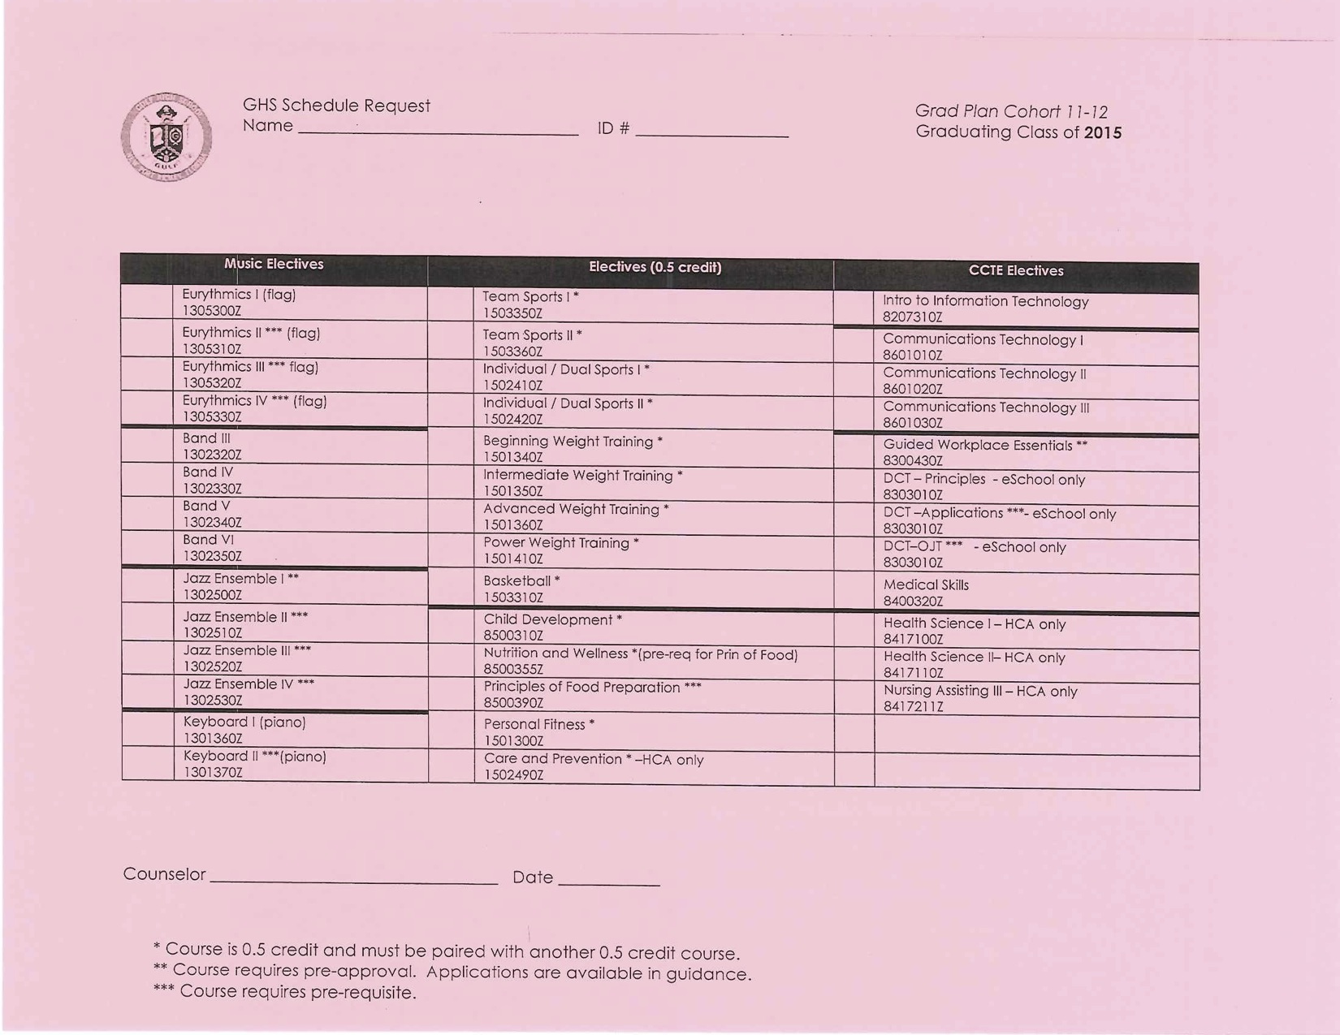

Slide 4
Number your choices:
1 – First choice for elective course
2 – Second choice for elective course
3 – Third choice for elective course
4 – Fourth choice for elective course
1 – 2 – 3- 4

Slide 5
Some things to consider:
Have you fulfilled your
ONLINE REQUIRMENT?
If not – you can CHOOSE eSchool for one of your elective choices. You can do your class online in GHS’s computer lab during one of your elective periods.

Slide 6
Some things to consider. . .
Health Career Academy
Journalism (Yearbook)
Music Tech & Sound Engineering (Morning News)
Guided Workplace
Gaming Design Academy (NEW at GHS!)
REQUIRE AN APPLICATION & TEACHER APPROVAL
Make sure you fill an application out if you would like one of these courses! Applications in GUIDANCE.

Slide 7
Some things to consider...
Have you fulfilled your 1 credit in FINE ART?
Classes that qualify:
Keyboarding (you must be able to read music)
Art 2 D
Art 3 D
Photography
Band
Intro to Information Technology
2 years of ROTC
Communications Technology

Slide 8
Some things to consider...
DUAL Enrollment at PHSC?
Need 3.0 Cumulative GPA
Take the PERT test at PHCC
Meet with your School Counselor
Available for Juniors & Seniors
Go to the information meeting coming to GHS this spring

Slide 9
Some things to consider....
Marchman Technical Education Center
Available for Juniors and Seniors
Application Required
Interested? See Guidance!
Want more information? Sign up in Guidance for this weeks presentation on February 20!

Slide 10
What is NEW at GHS?
Game Design Academy!
Game & Simulation Foundations Course (entry level course for the Game Design Academy)

Slide 11
Frequently Asked Questions
Do I need 2 years of the same foreign language if I want to go to college? YES
Do I need a foreign language for my High School Diploma? NO
Is Intensive Reading required if I did not pass FCAT? YES

Slide 12
Thank you for your cooperation! Please turn in your elective course card into your teacher TODAY!

