Slide 1




Financial Aid Overview
2011-12

Slide 2
Goals
By the end of this workshop, you will be able to:
  Define Financial Aid
  Comprehend the Financial Aid Process
  Understand Types of Financial Aid
      Federal
      State
      Institutional/Local
    Know Financial Aid Timeframes and Guidelines

Slide 3
What is Financial Aid?
Financial Aid is money received from state and federal governments and private institutions that is awarded to help students pay for college expenses

Slide 4
Types of Financial Aid
There are two types of financial aid: gift aid and self-help aid
Gift aid includes grants and scholarships – gifts of money to pay for college that don’t have to be repaid
Self-help aid includes employment, such as part-time jobs that help curb college expenses, and loans that you will need to repay
Financial Aid is based on demonstrated need and is designed to help students who cannot afford the cost of attending college
Scholarships based on merit should be seen as a reward for grades, special talents, creativity, leadership, or other criteria used to select recipients

Slide 5
College Costs
The average cost for published tuition and fees in a public two-year college per year is $2,713
The average cost for published tuition and fees in a public four-year college or university per year is $7,605
  Average surcharge for full-time out-of-state students at these institutions is $11,990
The average cost for published tuition and fees in a private four-year college per year is $27,293
Source for Statistics:
What it Costs to Go to College
College Board, 2010

Slide 6
The FREE Application for Federal Student Aid (FAFSA)

Slide 7
What is the FAFSA?
The Free Application for Federal Student Aid (FAFSA) is a form that current and prospective students must annually complete to apply for federal student aid
The FAFSA is distributed and processed by the largest source of student aid in the nation, the U.S. Department of Education
Applications are available electronically or in paper form
Students are encouraged to apply as soon as possible on or after January 1st
Completing the FAFSA is just the first step in the financial aid process

Slide 8
Before Beginning the FAFSA
Check ALL application deadlines
    School and state deadlines* may differ from federal guidelines
Confirm your dependency status*
Search for school codes*
Determine how you will submit the FAFSA
    Electronically (up to 14 days FASTER!)
      Electronic signature and submission requires a PIN. Establish a PIN before at www.pin.ed.gov or during the application process
    Manually
      Sign and mail the application to the address provided
    *Can be done online at www.fafsa.gov!

Slide 9
Before Beginning the FAFSA – Organize your documents
2011-12 documents needed to complete the FAFSA include:
  Your Social Security Number
  Your Driver’s License Number (if any)
  2011 W-2 Forms and other records of money earned
  Your 2011 Federal Income Tax Return for the current tax year
  Your parents’ 2011 Federal Income Tax Return (if you are a dependent student)
  Your 2011 untaxed income records
  Your current bank statements
  Your current business and investment mortgage information, business and farm records, stock, bond and other investment records
  Your alien registration or permanent resident card (if you are not a U.S. citizen)

Slide 10
“FAFSA on the Web” Worksheet
Allows you to read and complete FAFSA questions before entering your information online
Questions are listed in the same order that they appear on the official electronic application
Available online at: www.fafsa.gov
You can also obtain printed copies of this worksheet by calling 1-800-4-FED-AID (1-800-433-3243) or through your financial aid office

Slide 11
Complete the FAFSA - Electronically
  Go to www.fafsa.gov and click on “Fill Out Your FAFSA”
    Or complete the FAFSA by transferring the data from your “FAFSA on the Web” worksheet to your electronic application, if applicable
  NEW - IRS Data Retrieval option is now available
  Sign and submit the electronic FAFSA with your PIN
    Remember, you can apply for a PIN before or during the FAFSA process
    If you cannot remember your PIN, you may request a duplicate PIN by visiting www.pin.ed.gov

Slide 12
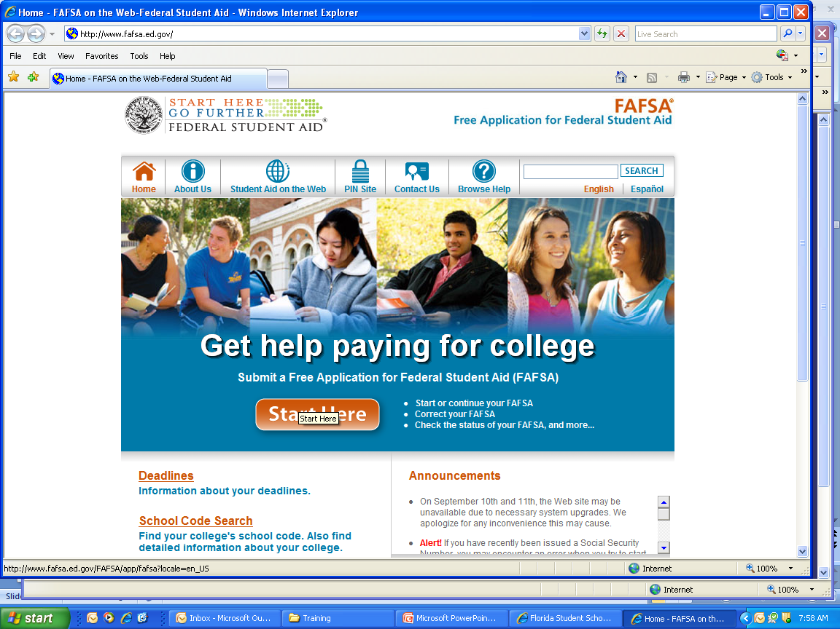
FAFSA Web site
FREE!

Slide 13
Complete the FAFSA - Paper
  You can request a paper FAFSA in English or Spanish from the Federal Student Aid Information Center by calling 1-800-4-FED-AID (1-800-433-3243)
    A .pdf version of the application is also available at www.fafsa.gov
  Complete, sign, and mail the FAFSA in the pre-addressed envelope, or send it to the address indicated in the .pdf version (if you printed one)
  Your FAFSA will be processed in two to three weeks
    May take longer during peak processing times

Slide 14
Your Student Aid Report (SAR)
You will receive:
    Your SAR by E-mail three to five days after your FAFSA has been processed, if you provided an E-mail address when you applied
    Your paper SAR by mail seven to ten days after your FAFSA has been processed, if you did not provide an E-mail address when you applied

Slide 15
Your Student Aid Report (SAR)
Your SAR will contain your official Expected Family Contribution (EFC)
  The U.S. Department of Education calculates your EFC, and sends your EFC to the postsecondary institutions you listed on your FAFSA
The postsecondary institutions will use your official EFC to determine how much financial aid you are eligible to receive, based on your school’s cost of attendance

Slide 16
Your Student Aid Report (SAR)
  After you submit your FAFSA, you will receive your Student Aid Report (SAR)
    Your SAR summarizes all the information you provided on your FAFSA
    Review your SAR carefully to make sure it is correct and complete
    Your institution may request additional information
  If you need to make any changes to your SAR, go to the FAFSA home page at www.fafsa.ed.gov, and click on “Make Corrections to a Processed FAFSA” under the “FAFSA Follow-Up” section of the home page
    If you received a paper SAR, you can make corrections on the paper SAR and mail it back to the address provided
    Check with your financial aid office BEFORE making any corrections to determine if they will file the corrections on your behalf

Slide 17
Information to Keep In Mind
Contact your school to determine your award eligibility
Your FAFSA may be used to apply for aid from other sources, including your school and state
If you need help filling out the FAFSA or if you have any questions about the FAFSA, call the Federal Student Aid Information Center toll-free at 1-800-4-FED-AID
Don’t forget to apply for grants, scholarships, or other financial aid at the institution you want to attend
Use student loans as a last resort

Slide 18

State Grants and Scholarships

Slide 19
State Grants & Scholarships
The Florida Department of Education, Office of Student Financial Assistance (OSFA) administers state-funded scholarship and grant programs and the Federal Family Education Loan Program
Please visit www.FloridaStudentFinancialAid.org for detailed information, applications, and deadlines

Slide 20
How to Apply for State
Grants & Scholarships
The Florida Financial Aid Application is available December 1st
Remember to apply early
Each scholarship and grant program has its own application deadline
Check the website for details
    Go to www.FloridaStudentFinancialAid.org
    Click on “State Grants, Scholarships & Applications”
    In the top blue toolbar, click on “Apply Here”
    Click on “Initial State Student Application”
  Check the website often to track application progress and make updates

Slide 21
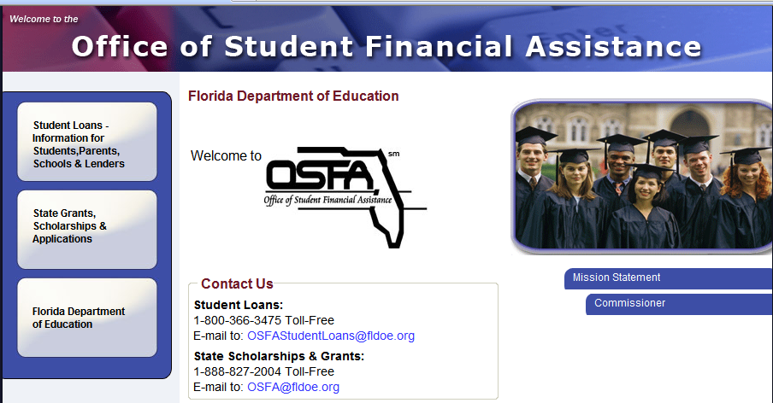
www.FloridaStudentFinancialAid.org

Slide 22
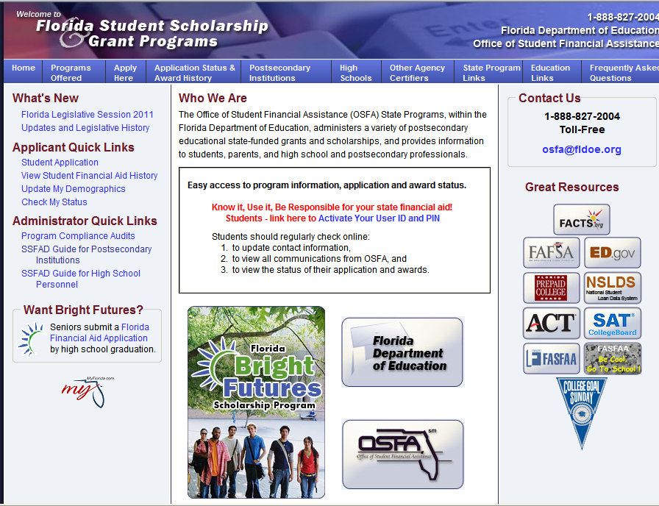
Student Application

Slide 23
Eligible Institution Information
Go to the OSFA State Programs website:
  http://www.FloridaStudentFinancialAid.org/SSFAD/home/uamain.htm
    Select an institution from the “Postsecondary Institution List”
    Click on “Search”
    A list of state grant and scholarship programs the institution is eligible to participate in will appear
    Compare institutions’ state grant and scholarship eligibility

Slide 24
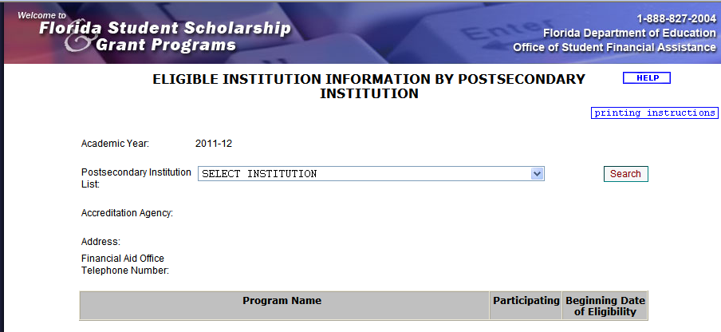
Eligible Institution Information

Slide 25
Types of State Grants & Scholarships

Slide 26
Florida Bright Futures Scholarship Program
The Florida Bright Futures Scholarship Program provides scholarships based on high school academic achievement and is Florida’s largest merit-based scholarship program
The Program offers three levels of scholarship awards – the Florida Academic Scholars (including Academic Top Scholars), the Florida Medallion Scholars, and the Florida Gold Seal Vocational Scholars
To be considered, a student must submit a completed (error-free) Florida Financial Aid Application during his or her last year in high school (after December 1st and prior to graduation)
Eligibility requirements can be viewed at:
  http://www.FloridaStudentFinancialAid.org/SSFAD/factsheets/BF.htm
Award amounts can be viewed at:
  http://www.FloridaStudentFinancialAid.org/SSFAD/bf/awardamt.htm

Slide 27
2010 Legislative Changes
Beginning with 2009-10 high school graduates
  100% of program of study
    FAS/FMS = up to 120 semester hours (or equivalent in quarter or clock hours)
    GSV = up to 90 semester hours (or equivalent in quarter or clock hours)
  Students have a one-time opportunity for restoration for insufficient GPA in first year of funding only
  FAS/FMS students who receive first baccalaureate degree in 2010-11 and thereafter, in seven semesters or fewer, may receive funding for one semester of graduate study, not to exceed 15 semester hours, paid at undergraduate rate

Slide 28
2010 Legislative Changes (continued)
Beginning with 2010-11 high school graduates
  Number of years of funding available is up to five years from high school graduation
    Changed from seven years
  Students unable to complete program of study after five academic years due to illness or emergency may be granted a one-year extension

Slide 29
2011 Legislative Changes
FAFSA Requirement
Students are now required to submit a complete, error-free FAFSA for
  Bright Futures, Florida Resident Access Grant, and Access to Better Learning and Education Grant
    Required annually of initial and renewal students any time prior to disbursement
    No FAFSA = No $$
Community service requirements increased for all three Bright Futures award levels
  FAS – 100 hours (increased from 75 hours)
  FMS – 75 hours (increased from 0 hours)
  GSV – 30 hours (increased from 0 hours)

Slide 30
2011 Legislative Changes
Test Score Requirements
Raising the Bar for Juniors, Sophomores & Freshmen
Home educated students graduating 2013-14 who are unable to document college preparatory and wish to earn FMS must earn 1220 SAT or 27 ACT.
Graduation Year | Year of Initial Eligibility | FAS SAT ACT |  | FMS SAT ACT
2011-12 | 2012-13 | 1270 | 28 | 980 | 21
2012-13 | 2013-14 | 1280 | 28 | 1020 | 22
2013-14 | 2014-15 | 1290 | 29 | 1170 | 26

Slide 31
Other State Grants
& Scholarships
The Initial State Student Application also determines your eligibility for other state grants and scholarships administered by the state of Florida
  José Martí Scholarship Challenge Grant Fund
  Rosewood Family Scholarship Program
  Scholarships for Children and Spouses of Deceased or Disabled Veterans and Servicemembers
For more details about these state programs, please visit:
www.floridastudentfinancialaid.org/SSFAD/home/ProgramsOffered.htm

Slide 32
Other State Grants
& Scholarships
Your institution will determine your eligibility for other state grants and scholarships administered by the state of Florida
  Florida Student Assistance Grant
  Florida Resident Access Grant
  Access to Better Learning and Education Grant
  Florida Work Experience Program
  Mary McLeod Bethune Scholarship
For more details about these state programs, please visit:
www.floridastudentfinancialaid.org/SSFAD/home/ProgramsOffered.htm

Slide 33
www.facts.org
  Florida Academic Counseling and Tracking for Students (facts.org) is Florida's official online student advising system that can assist high school students, college students, parents, and even counselors to help plan and track educational progress in Florida
  Go to www.facts.org:
Click on “High School Students”
Click one of the links under “Plan and Track Progress”
Requires User ID/Password

Slide 34
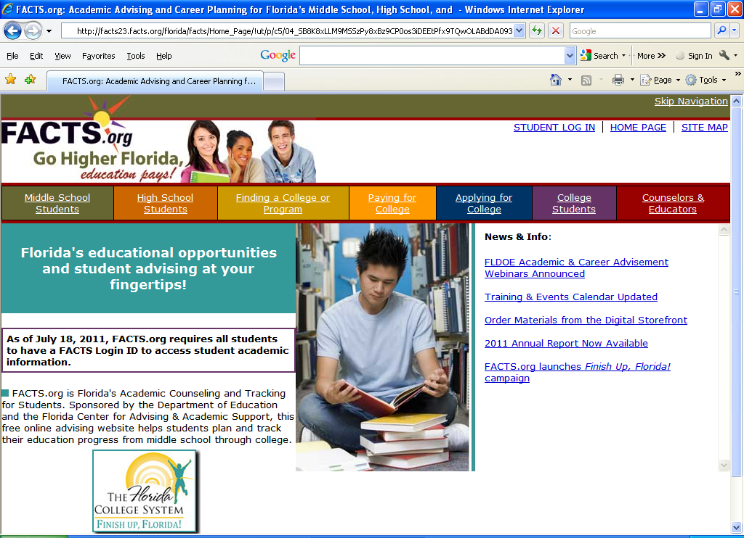
www.facts.org

Slide 35
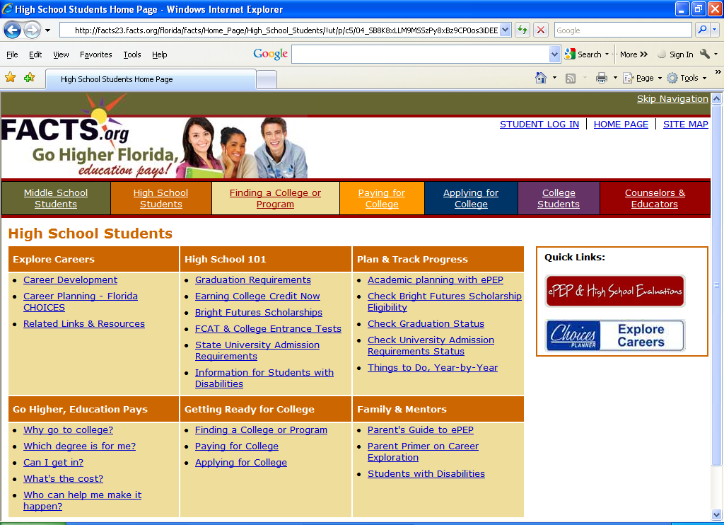
www.facts.org - Check Bright Futures Eligibility

Slide 36
Searching for Other
Types of Aid

Slide 37
www.fastweb.com
  FastWeb offers a free scholarship database that includes over 1.3 million scholarships worth over $3 billion
  Database sources include local, national, and college-specific scholarships
  Search and compare detailed college profiles on FastWeb’s database
  FastWeb’s database allows you to also search for internships or part-time job openings near your home or school
  FastWeb is recommended by more than 16,000 schools and 3,600 colleges
  Access FastWeb by visiting www.fastweb.com
    requires User ID and Password

Slide 38
Other Sources
  Use www.finaid.org to search for available monies through scholarships and grants nationwide
  High School Guidance Office
  Be aware of recent scholarship scams
    Scams can be received via phone, letter in the mail, or E-mail
    Visit the Federal Trade Commission (FTC) website at www.ftc.gov for additional information on scams, or contact the FTC by calling 1-877-FTC-HELP (1-877-382-4357) or TTY 1-866-653-4261

Slide 39
Tax Incentive Programs:
American Opportunity Tax Credit
When thinking about paying for college, do not forget about some of the tax incentives that can help to make college affordable for you
  The American Opportunity Tax Credit
    This tax credit applies to tuition and fee expenses for the first four years of a college education
      Students need to:
        Be claimed as a dependent
        Be enrolled at least half-time
        Have a family adjusted gross income of $90K or less ($180K or less for joint filers)

Slide 40
Tax Incentive Programs:
Lifetime Learning Credit
The Lifetime Learning Credit allows up to $2,000 per tax return, for an unlimited number of years, and may be used for courses outside of a degree or certificate program
    Students need to
      Be enrolled in at least one course
      Be claimed as a dependent
      Have a family adjusted gross income of $60K or less ($120K or less for joint filers)

Slide 41

IMPORTANT!
Keep copies of ALL financial aid documents!

Slide 42
Navigating Your
Financial Future
OSFA offers a variety of tools and resources to assist you in your pursuit of higher education
For more information, please visit: www.navigatingyourfuture.org

Slide 43
For More Information
www.FloridaStudentFinancialAid.org
E-mail: OSFA@fldoe.org
1-888-827-2004 (Grants/Scholarships)
1-800-366-3475 (Student Loans)
Outreach Representative:
  Insert (Name of Representative)
  Insert (contact information)

Slide 44
Questions?

Slide 45
Thank you for attending
this workshop

