Slide 1
Notes:
Macri speaks
Introduce names

Slide 2
IB DIPLOMA PROGRAM FOR THE CLASS OF ‘24
Gulf High School
Notes:
Macri speaks
Introduces IB Program

Slide 3
IB VIDEO
https://youtu.be/whdnqWVTeDU

Slide 4
Target Audience
Parents/Guardians of current 8th grade students who are now studying or already have completed Algebra 1 or Algebra 1 Honors. Applicants must be zoned for either GHS, AHS, FHS, HHS, JWMHS, or RRHS.
For more information, please visit:
http://www.pasco.k12.fl.us/pasco_choice_catalog/international_baccalaureate
Notes:
Macri: Gulf, Anclote, Fivay, Hudson, Mitchell, or River Ridge
”Students just like you”
We were sitting in their seat 4 years ago

Slide 5
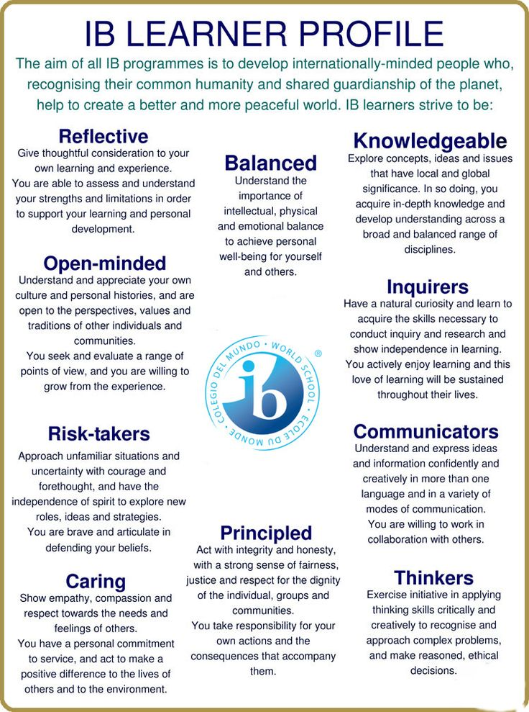
Notes:
Macri: What kind of student the IB Program wants to develop

Slide 6
Notes:
Macri first

Slide 7
College Credits = $
7 AP courses in the IB Course Sequence
6 IB courses in the IB Course Sequence
2 Elective courses that may be AP choices
15 courses at 3 credits each = 45 credits!
60 credits is required for an Associates Degree
Average in-state college fees and tuition are $9650.00 and the average student enrolls in 30 hours (typical of a year long course load) of credit. The cost per credit hour is approximately $322.00. A typical 3 hour course would cost $965.00

Slide 8
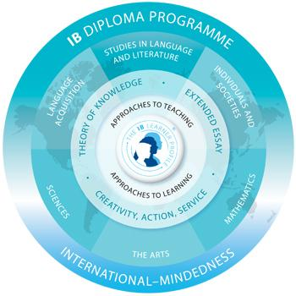
IB DIPLOMA PROGRAM MODEL
The curriculum is modeled by six academic
areas surrounding the three core requirements.
Notes:
Nikodem: IB requires Internal assesments and extra requirements outside the classroom, but don’t let this scare you, because you’ll have a long time frame to complete these requirements and will have developed complex problem-solving skills afterwards to help you in the real world.
Luke: Each academic area requires an Internal Assessment which forces you to apply what you have learned towards a topic of your choice (5 IAs and a world literature paper will be due during senior year, accounting for 20% of your final course grade) . Personally writing IAs have taught me to understand how material learned in class is involved in the real world, which something ap does not enforce. This skill of applying knowledge prepares you properly for what is to come in college.

Slide 9
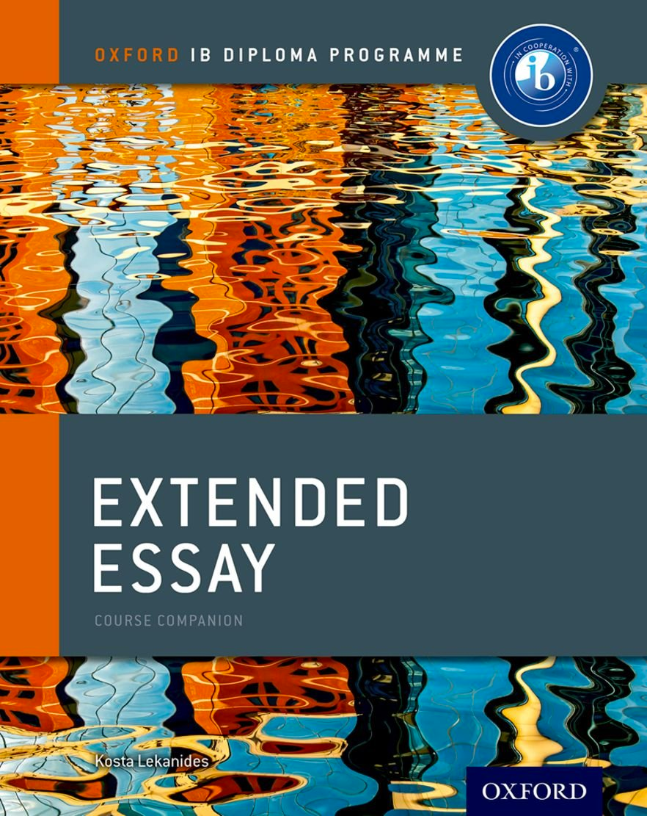
IB CORE CURRICULUM
In addition, to receive the IB Diploma students must complete:
Extended Essay – 4,000 words! You choose the subject and topic. A mentor is assigned to you to begin the process in your junior year.
Theory of Knowledge – a course designed to teach you about knowledge and the process of thinking. You will think about thinking!
Creativity, action, service (CAS) – a project that you choose to benefit someone else. It is something that you are interested in and want to share with others in need.
Notes:
Jessica: The EE is assigned to students december of their junior year and are assigned a mentor and hand book to help them along the way. Without procrastination CAS and EE are not monumentous tasks
niko/ jessica: Personal EE experience
Yusuf and Luke: Describe each topic and tell our experiences
Luke: EE- My biology extended essay totaled 3,919 words and 23 pages in total, working on the EE proved to be challenging but it taught me patience and persistence, and Ms Macri’s so called friendly reminders were also much appreciated, jk she was very helpful
Yusuf: My psychology EE was originally over 4600 words and I had to cut it down. My final word count was 3999
Luke: TOK- Tok will be the craziest class you have ever experienced, every day you leave class wondering what just happened, Example: I want all of you to think exactly how a dog would, raise your hand if you think you correctly imagined a dogs thought process, now all of you that raised your hand are wrong because you thought about how the dog thinks in English, and dogs don’t know English , so how does a dog really think, these are the type of mind boggling concepts we examine daily
Yusuf: CAS is basically a series of reflections on things that you’ve done to benefit your persona or help your community. I’m not a big CAS guy because I’m not the kind of guy that likes to talk about my day, but it’s easy.

Slide 10
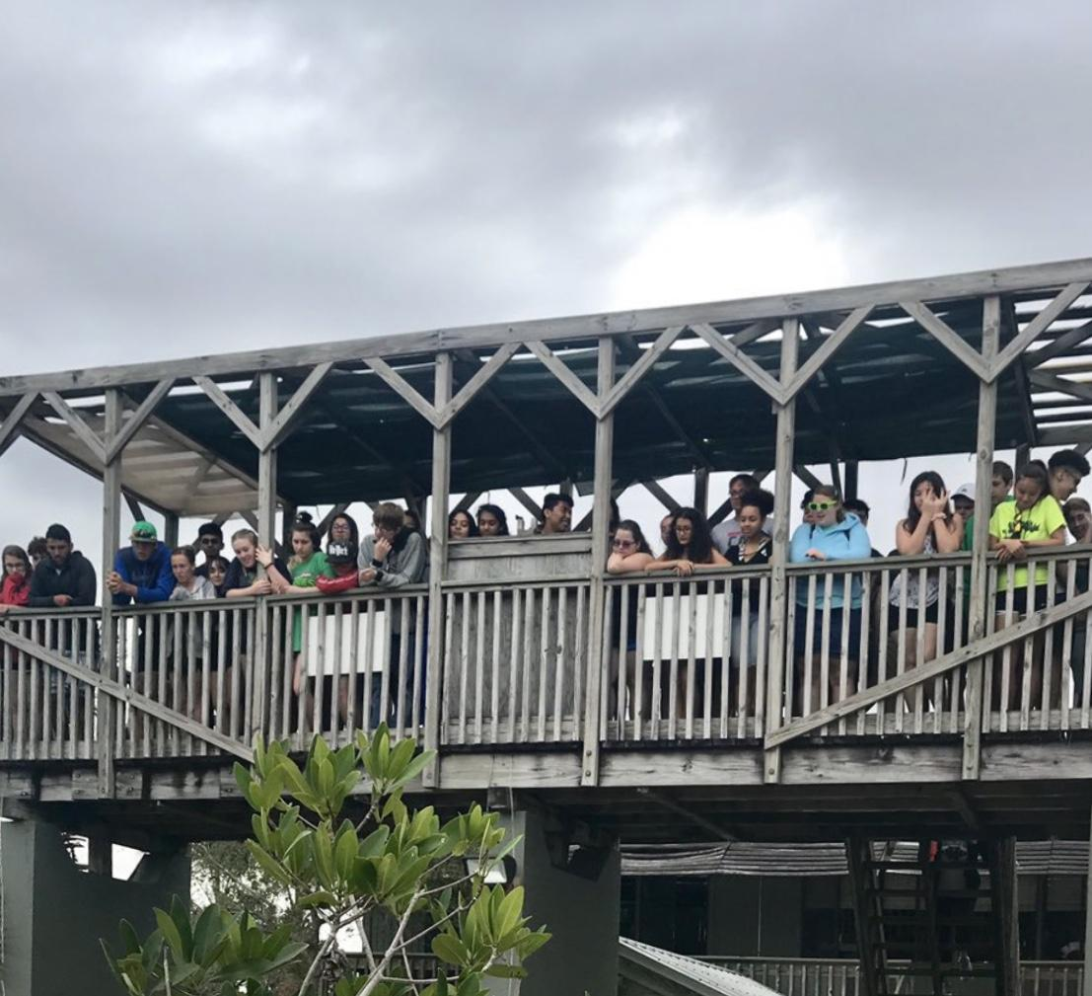
GROUP 4
The Group 4 project is a three day field trip to the EMC in your junior year.
At the EMC you conduct an experiment with a group of 3 other students of your choice.
Once you’ve completed your experiment you simply write a quick lab report.
Notes:
. Two day field trip
day1- go around the facility and figure out what you want your project to be
day 2- Execute an experiment you come up with in a group
talk about our own experiences

Slide 11
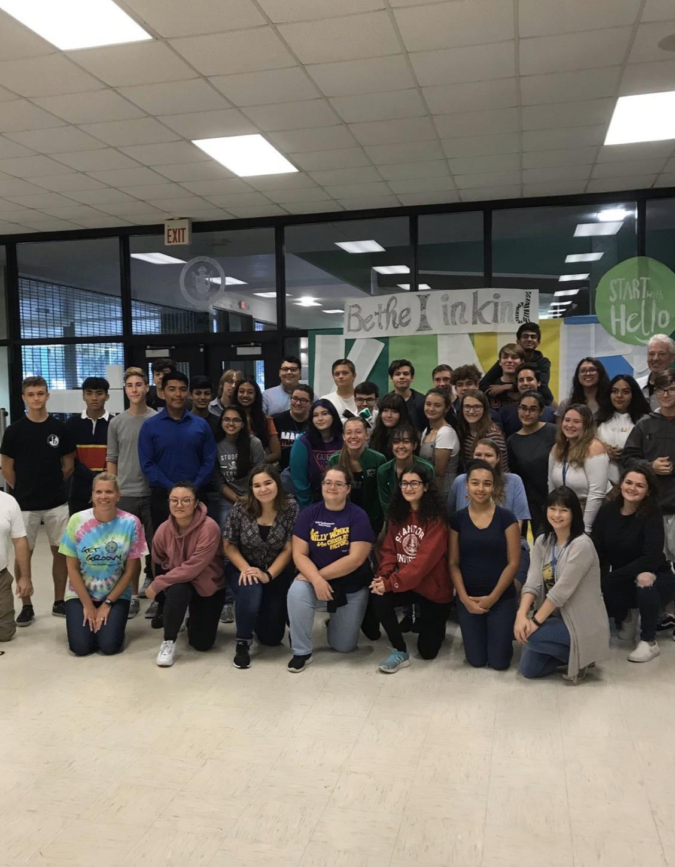
IB ENTERTAINMENT
Each month all four IB classes meet for an activity led by Ms. Macri
Activities include:
Picnics
Breakfast
Beyblade tournaments
Bounce house field day
Coffee Houses
Notes:
Luke: Bounce house field day, not yet approved by ms macri yet (look at ms macri) “pleaseee”
Luke: My personal favorite being breakfast during first period, you cant name something that beats missing Spanish in the morning while eating free bagels, all thanks to ms macri
Yusuf: as you can see every one is enjoying themselves, even my French teacher is happy to ms French (point out she is bottom left) Also point out me and Luke

Slide 12
$ COLLEGE $
Graduating seniors (Class of 2018 Traditional and IB) earned over $1.5 million in scholarship money!
This includes Florida Bright Futures Scholarships, Institutional scholarships, local scholarships, National Merit, and athletic scholarships.
Notes:
Merit based scholarships at specific schools
Luke: IB automatically gives Bright Futures with completion of 100 volunteer hours stemming from CAS , IB is recognized by all colleges on a global scale
Yusuf and Luke: What colleges we’re applying to
What colleges our friends are applying to
What we’re doing with our lives, FANCY TALK

Slide 13
IB DIPLOMA ACCEPTANCE RATES
WITHOUT IB DIPLOMA
WITH IB DIPLOMA
MIT= 7.2%
Stanford= 4.65%
University of Michigan= 28.6%
Duke= 9%
MIT= 23.1%
Stanford= 17%
University of Michigan= 70.8%
Duke= 36.2%
Notes:
where we applied
Yusuf: Huge statistical variance
I think USF has like an 89% acceptance rate of IB kids opposed to its 46% for other classes

Slide 14
Notable College Acceptances in the past 4 years:
Duke University Stanford University
New York University Georgetown University
Emory University University of Florida
University of South Florida Florida State University
University of California University of Central Florida
Florida Gulf Coast University St. Leo University
Carnegie Mellon University Wellesley University
University North Carolina Rice University
Tulane University Embry-Riddle Aeronautical
John Hopkins Harvard
Georgia Institute of Technology Princeton
Brown University Berkeley
Notes:
Yusuf: Point out the notable colleges

Slide 15
Across different studies, researchers have found that:
Diploma Programme (DP) curriculum and assessment compares favourably to a variety of other respected qualifications
DP students tend to complete their undergraduate degrees at higher rates than their peers, and often in less time.
IB students can tend to make more contributions to campus life by participating in activities such as community service, tutoring, assisting faculty in research, study abroad, internships, and joining clubs and other student groups.

Slide 16
Across the research, DP students have been cited as demonstrating the following skills:
Interest and experience in research
Time management and organizational skills
Critical thinking, inquiry and problem solving
Strong language and writing skills
International-mindedness and a sense of responsibility for the community

Slide 17
WHAT DOES THE IB PROGRAM DO FOR ME?
Gives higher likelihood of getting accepted into college
Ability to create family like bond with like minded peers
Answers the classic question of “What am I learning this for??”
Teaches how to write concisely
Increases likelihood of getting leadership positions in school clubs
IB classes weight your GPA on a 5.0 scale
Enforces critical thinking as opposed to memorization of content
The classes are FUN
Notes:
Yusuf

Slide 18
New School Choice and Magnet Application Windows
Application Window Timeline
December 3rd- 13th application window
January 11th- Writing Sample @ GHS
February 4th - 13th Parents/students notified of acceptance
Apply at:
https://www.pasco.k12.fl.us/school_choice_overview/page/school-choice-overview-apply-here
.
Pasco Pathways Expo
November 18th 5:00-8:00 @ River Ridge High School
Notes:
Macri

Slide 19
Dean of Admissions at Stanford
https://blogs.ibo.org/blog/2016/04/26/stanfords-assistant-dean-of-admissions-on-the-value-of-an-ib-education/

Slide 20
CONTACT INFORMATION:
Kristen Lea, IB Guidance Counselor
klea@pasco.k12.fl.us
Cheryl Macri, IB Coordinator
cmacrigr@pasco.k12.fl.us
Jeff Morgenstein Principal, Gulf High School
jmorgens@pasco.k12.fl.us
Notes:
Macri

